Slide 1
WEB AUTHORING: DW, PHP, MYSQL
SESSION 07 – JAVASCRIPT FORM VALIDATION

Slide 2
OBJECTIVES
Event Handles
Using Event Handles
DOM
Access Form Data
Validation

Slide 3
Event object
Events are actions that can be detected by JavaScript.
Each event has an associated event object. The event object provides information on:
the type of event
the location of the cursor at the time of the event

Slide 4
Life cycle of an Event
The life cycle of an event generally consist of following steps:
The user action or condition associated with the event occurs
The event object is instantly updated to reflect the conditions of the event
The event fires
The associated event handler is called
The event handler carries out its actions and returns

Slide 5
Event Handlers
Event Handler are categorized as:
Event handlers for HTML tags
<TAG eventHandler="JavaScript Code">
Ex:
<INPUT TYPE="button" NAME="docode" onClick="DoOnClick();">
Event Handlers as Properties
object.eventhandler = function;

Slide 6
Javascript Event
Common events supported by JavaScript includes:
onClick
onChange
onFocus
onBlur
onMouseOver
onMouseOut
onLoad
onSubmit
onMouseDown
onMouseUp

Slide 7
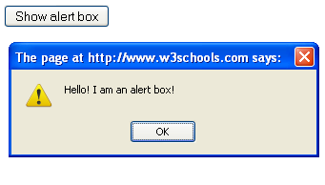
A onClick sample
The onClick event is generated whenever the user clicks the mouse button on certain form elements or on a hypertext link.
<html>
<head>
<script type="text/javascript">
function show_alert()
{
alert("Hello! I am an alert box!");
}
</script>
</head>
<body>
<input type="button" onclick="show_alert()" value="Show alert box" />
</body>
</html>

Slide 8
A onChange sample
The onChange event occurs whenever a form element changes.
<HTML>
<HEAD>
<SCRIPT LANGUAGE="JavaScript">
function check(num)
{
if (num == "")
{
alert("Please enter a text");
return false;
} else {
alert ("Thank you");
}
}
</SCRIPT>
</HEAD>
<BODY bgColor = white>
<FORM>
Please enter a text:
<INPUT type = text size = 5 onChange="check(this.value)">
</FORM>
</BODY>
</HTML>

Slide 9
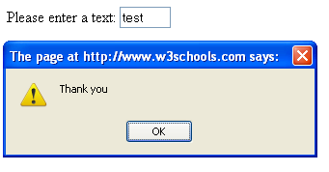
OnChange output

Slide 10
onFocus and onBlur
onFocus:
The onFocus event is sent whenever a form element becomes the current form element.
Only when an element has the focus can it accept input from the user.
onBlur:
Blur is the opposite of focus.
When the user leaves a form element, the onBlur event is activated.

Slide 11


onFocus and onBlur sample
<HTML>
<HEAD>
<SCRIPT LANGUAGE="JavaScript">
function changebg(id, color)
{
id.style.backgroundColor=color;
}
</SCRIPT>
</HEAD>
<BODY bgColor = white>
<FORM>
Please enter a text:
<INPUT type = text onFocus="changebg(this,'yellow');" onBlur="changebg(this,'white');">
</FORM>
</BODY>
</HTML>

Slide 12
onMouseOver and onMouseOut
onMouseOver
The onMouseOver event is generated whenever the mouse cursor is moved over an element.
onMouseOut
The onMouseOut event is generated whenever the mouse cursor moves off of an element.
<a href="http://abc.com" onmouseover="alert('An onMouseOver event');return false“ onMouseOut=“alert(‘An onMouseOut event’);”>This is test</a>

Slide 13
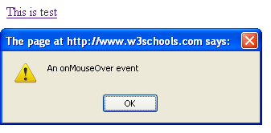
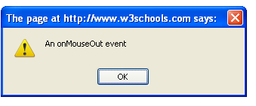
OnMouseOver/OnMouseOut output

Slide 14
onLoad and onSubmit
OnLoad
The onLoad event is sent to the document body object when the document has finished loading.
onSubmit
The onSubmit event is generated whenever the user submits a form (using the "Submit" button).
The event occurs before the form is actually submitted.

Slide 15
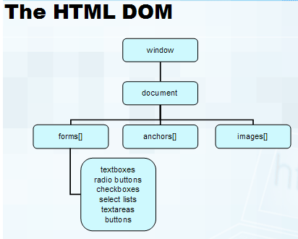
Document Object Model (DOM)
DOM is the browser's view of an HTML page as an object hierarchy

Slide 16
DOM (cont…)
One important feature of JavaScript is that it is Object based language.
Helps the user to develop program, which are modular and reusable.
An object can be defined as a single entity, consisting of Properties and Methods.
A property is a value that belongs to an object.
Eg: document.bgColor

Slide 17
Window object
It represents the browser’s window and can be used to retrieve information about the state of the window
Properties:
document
event
history
location
name
navigator
screen
Methods:
alert
blur
close
focus
navigate
open

Slide 18
Document object
It represents the HTML document in a given browser window and is used to retrieve information about the document
Properties:
alinkColor
bgColor
Body
fgColor
linkColor
location
Title
URL
vlinkColor
Methods:
clear
close
open
write
writeln

Slide 19
Access form element
All forms on a web page are stored in the document.forms[] array.
The first form on a page is document.forms[0], the second form is document.forms[1], and so on
It is usually easier to give the forms names and refer to them that way
Syntax
document.FormName.ElementName

Slide 20
Textfield object
Textfield understands onBlur, onFocus, and onChange events
<input type="text" name="first_text" onFocus="writeIt('focus');" onBlur="writeIt('blur');"
onChange="writeIt('change');">

Slide 21
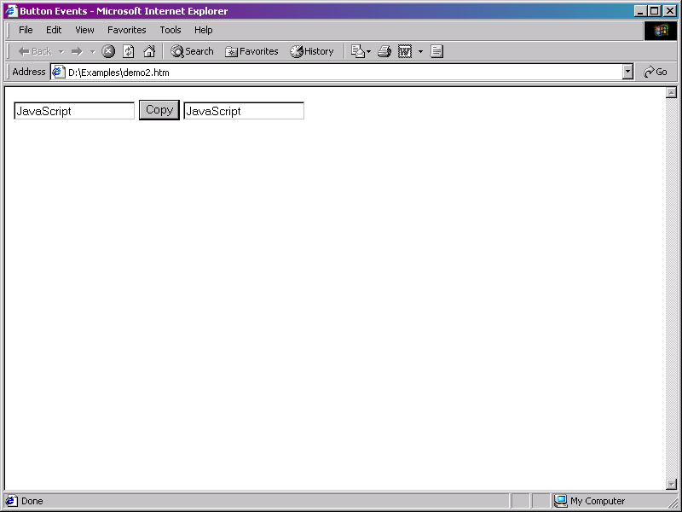
Command Button object
Command button understands onClick event
The onClick event occurs when user clicks on a command button
<INPUT TYPE="button" value="Copy" onClick=“copy(myfm.text1.value);">

Slide 22
Option Button/Radio Button object
Radio buttons are almost exactly like checkboxes with respect to JavaScript
Radio buttons are different. Once a radio button is on, it stays on until another one is selected. Then the first one goes off.
Option or radio button also understands onClick event.

Slide 23
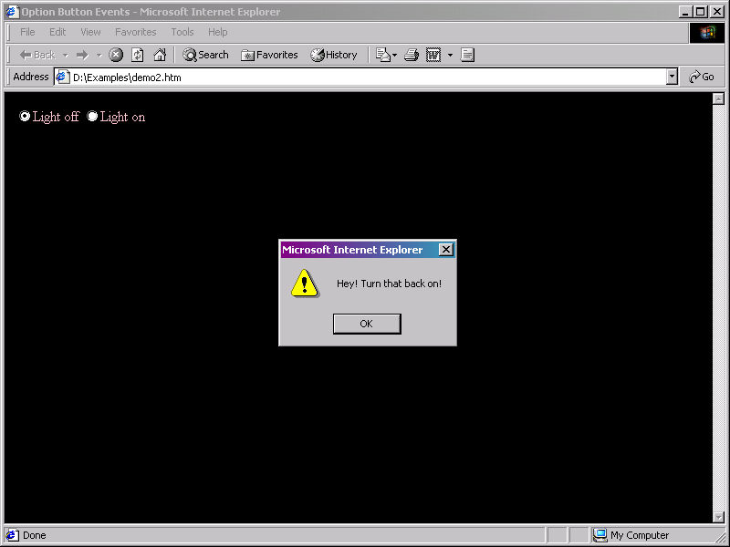
Radio sample

Slide 24
ComboBox/Select object
A ComboBox object on an HTML form appears as drop-down list or a scrollable list of selectable items
To conserve form space, the scrollable list of selectable items is used
ComboBox supports onBlur, onFocus, and onChange events

Slide 25
JavaScript Form Validation
JavaScript can be used to validate data in HTML forms before sending off the content to a server.
Form data that typically are checked by a JavaScript could be:
has the user left required fields empty?
has the user entered a valid e-mail address?
has the user entered a valid date?
has the user entered text in a numeric field?

Slide 26
Required Fields
function validate_required(field,alerttxt)
{
with (field)
{
if (value==null||value=="")
{
alert(alerttxt);return false;
}
else
{
return true;
}
}
}

Slide 27
E-mail Validation
function validate_email(field,alerttxt)
{
with (field)
{
apos=value.indexOf("@");
dotpos=value.lastIndexOf(".");
if (apos<1||dotpos-apos<2)
{alert(alerttxt);return false;}
else {return true;}
}
}

Slide 28
Summary
The event object provides information on:
the type of event
the location of the cursor at the time of the event
The event object is used as a part of an event handler. The life cycle of an event generally consist of following steps:
The user action or condition associated with the event occurs
The event object is instantly updated to reflect the conditions of the event
The event fires
The associated event handler is called
The event handler carries out its actions and returns
Form validation is the process of checking that a form has been filled in correctly before it is processed.

